Slide 1
Using the Linux Servers
Code Camp Week 2

Slide 2

What are they?
The Linux servers are a bunch of machines that are running the Linux operating system
They have software that is useful and necessary for UCLA computer science courses
Professors test student code using these servers
Make sure to test your code before submitting

Slide 3
Software Used
On Windows
On Mac
Cisco AnyConnect
Used to login to VPN
Need to download Putty
Used to login to the server
Optional download: WinSCP
Used to transfer files to/from the server
Cisco AnyConnect
Used to login to VPN
Use the Terminal app to login to the server

Slide 4
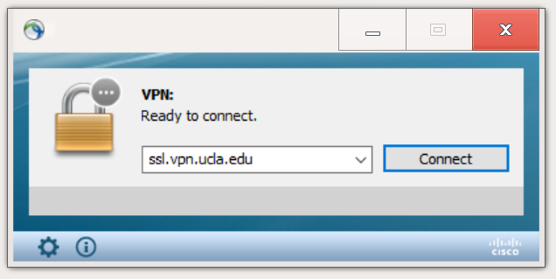
Connecting to the VPN
Once installed, open the Cisco AnyConnect application
The start screen should look like this
Type ‘ssl.vpn.ucla.edu’ into the text box
Press enter

Slide 5
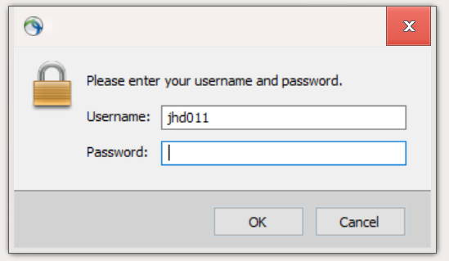
Connecting to the VPN
Sign-in using myUCLA credentials
This is going to send a multi-factor authentication alert so approve that
Once you sign-in you should be connected to the VPN

Slide 6
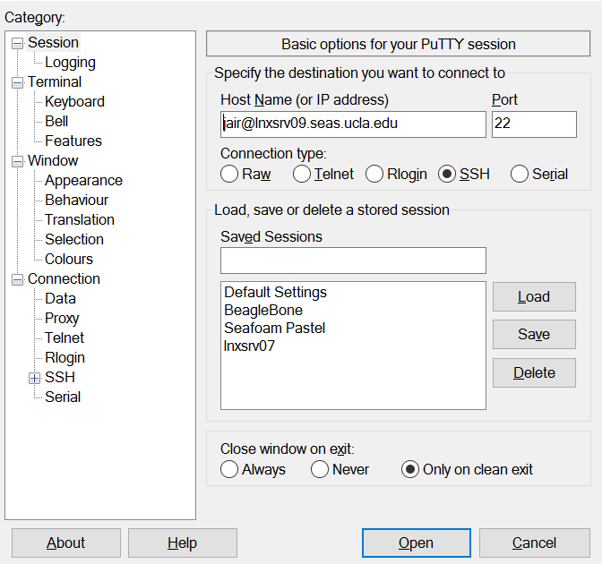

Signing In: Windows
SEASnet username
Name of the server

Slide 7
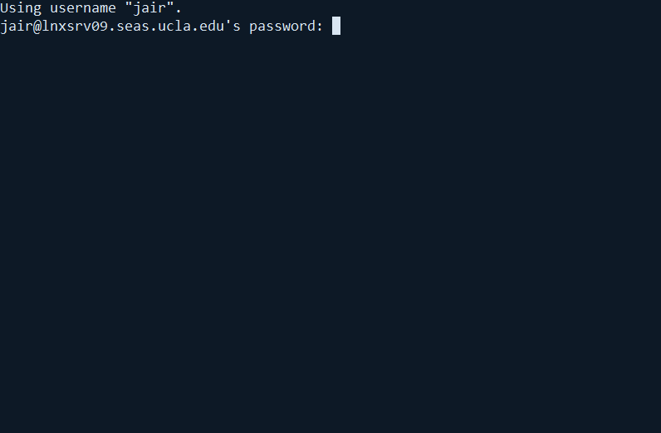
Signing In: Windows
Type in your SEASnet password
If no characters appear, don’t worry, that is normal
Hit enter when you are done

Slide 8
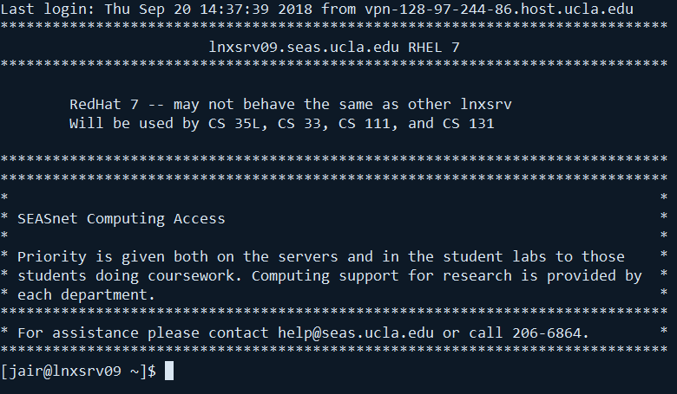
Signing In: Windows
If you see a page similar to this, you are done!

Slide 9

Signing In: MacOS
Type in your SEASnet password
If no characters appear, don’t worry, that is normal
Hit enter when you are done
SEASnet username
Command used to login
Name of the server

Slide 10
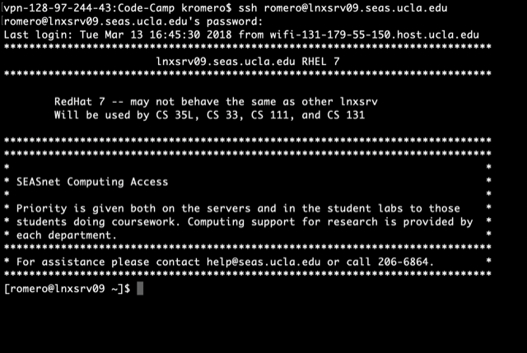
Signing In: MacOS
If you see a page similar to this, you are done!

Slide 11
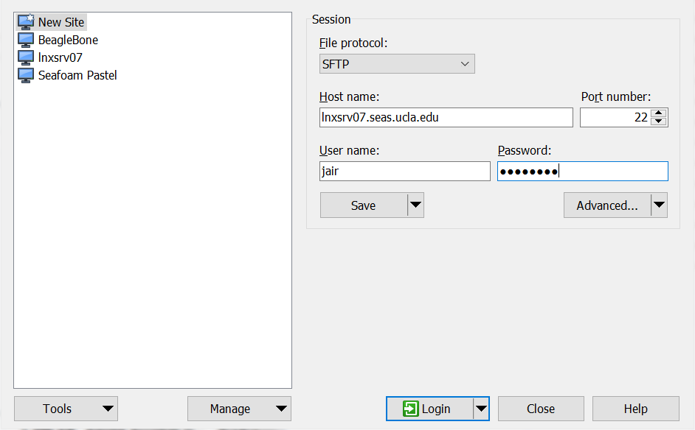
Getting Files on the Server: Windows
Host name is the name of the server we used earlier
User name and password are the SEASnet credentials

Slide 12
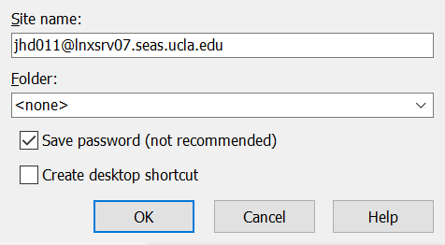
Getting Files on the Server: Windows
Before logging in, press save to avoid having to enter all the information next time
Click save password

Slide 13
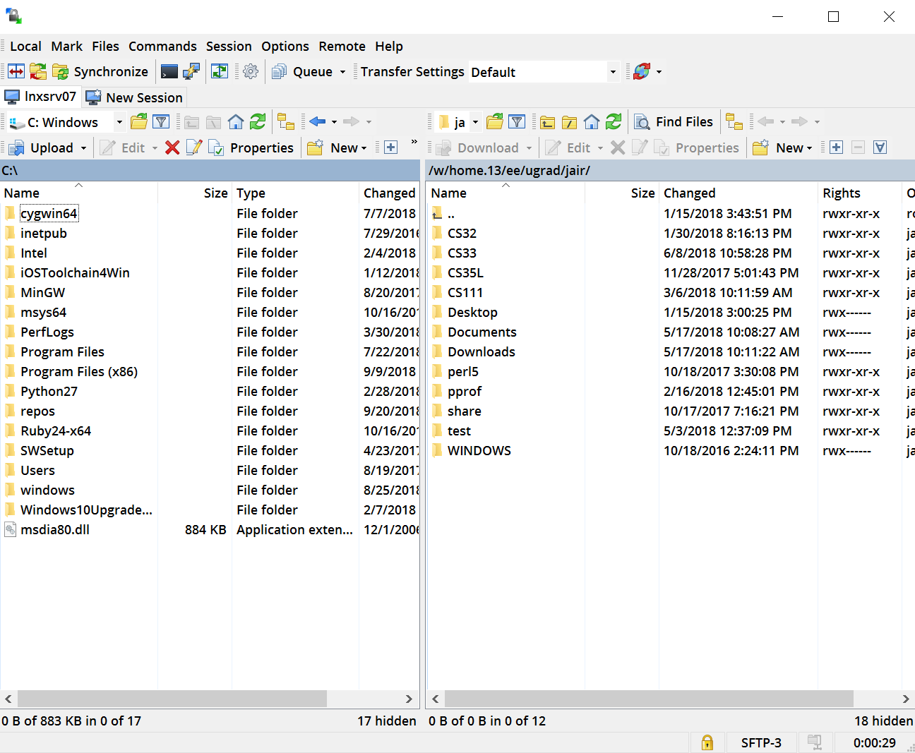
Getting Files on the Server: Windows
The left is your local computer file system
The right is the Linux server file system
You could easily drag and drop across both

Slide 14
Getting Files on The Server: MacOS
File to copy
Directory to copy into
SEASnet Hostname
SCP is the name of the command we will be using
The file to copy is the first parameter
The second parameter follows the format:
<hostname>:<dir>
<dir> most often starts with ‘~’
This indicated your account’s home directory

Slide 15
Getting Files on The Server: MacOS
And now we have the file on the Linux server ☺

Slide 16
Using the System
The servers run on a command line interface
The system provides a set of commands to navigate and use the system
The alternative is providing a graphical interface like Windows or MacOS
Navigating the file system:
ls: Print the contents of the current directory
mkdir <dir>: Create a directory with the name “dir”
cd <dir>: Go into the directory with the name “dir”
emacs <file>: Modify or create a file with name “file”
This is a text editor used to write files
Has lots of integrated commands

Slide 17
Compiling and Running Code
Run the following command while on the server
curl -s -L http://cs.ucla.edu/classes/fall18/cs31/Utilities/setupg31 | bash
To compile code you use the following command
g++ -o <name of executable> <name of cpp file>
eg: g++ -o test test.cpp
To run the executable and test your code you use
./<name of executable>
eg: ./test

Slide 18
Software Links
Cisco AnyConnect
Mac OS: https://ftp.bol.ucla.edu/pub/bol/vpn/software/anyconnect-macos-4.6.00362.dmg
Windows: https://ftp.bol.ucla.edu/pub/bol/vpn/software/anyconnect-win-4.6.00362.msi
Putty:
https://www.chiark.greenend.org.uk/~sgtatham/putty/latest.html

